Slide 1

Mac Model in dbms
NAME – ABHIRUP BAG ROLL – 13000122082 DEPARTMENT – CSE(B) SEMESTER – 6 PAPER – Database Management System (PCC-CS601)

Slide 2

content
Introduction
How does MAC Work ?
Key Features of MAC
MAC vs. Discretionary Access Control (DAC)
Advantages of MAC in DBMS
Challenges of MAC
MAC in Database Management Systems (DBMS)
Real-World Applications
Conclusion
References
3
4
5
6
7
8
9
10
11
12

Slide 3

INTRODUCTION
What is MAC?
A security model where access to resources is strictly controlled by a central authority.
Uses security labels (e.g., confidential, secret, top secret) for users and data.
Purpose:
Prevent unauthorized access to sensitive data.
Ensure compliance with security policies and regulations.

Slide 4




How does MAC Work ?
Key Components :
Subjects: Users or processes requesting access.
Objects: Data or resources being accessed.
Security Labels: Assigned to both subjects and objects (e.g., clearance levels).
Access Rules:
Access is granted only if the user’s clearance matches or exceeds the data’s classification.
Example: A user with "secret" clearance can access "secret" or "confidential" data but not "top secret."

Slide 5
Key Features of MAC
✅ Centralized Control – Unlike parametric methods (e.g., normal distribution with mean and variance), non-parametric methods do not assume a predefined shape for the data distribution.
✅ Security Labels – These methods rely on the structure of the observed data to make inferences.
✅ No Discretionary Access – Non-parametric methods adapt to data patterns but often require larger sample sizes to achieve similar accuracy as parametric methods.
✅ Data Classification – Confidentiality is enforced.

Slide 6
MAC vs. Discretionary Access Control (DAC)
1
Mandatory Access Control
Centrally managed by administrators.
Strict, non-negotiable access rules.
Ideal for high-security environments.
2
Discretionary Access Control
Users can set permissions for their resources.
More flexible but less secure.
MAC enforces mandatory policies, while DAC allows discretionary control.

Slide 7

Advantages of MAC in DBMS
1
2
3
Strong Security: Prevents unauthorized access and data breaches.
Consistent Enforcement: Centralized control ensures uniform application of policies.
Compliance: Helps meet regulatory and legal requirements.
4
Protection of Sensitive Data: Ideal for classified or confidential information.

Slide 8
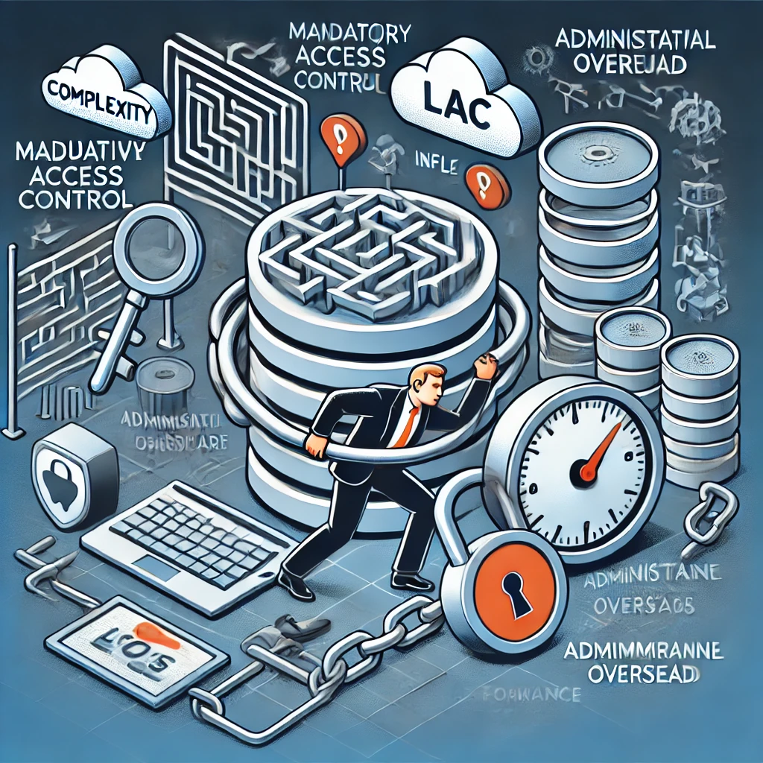
Challenges of MAC
1
2
3
Rigidity: Strict policies can reduce flexibility and usability.
Complexity: Requires careful management of security labels and policies.
Administrative Overhead: Centralized control demands significant administrative effort.
4
User Productivity: Strict access rules may hinder workflow efficiency.

Slide 9
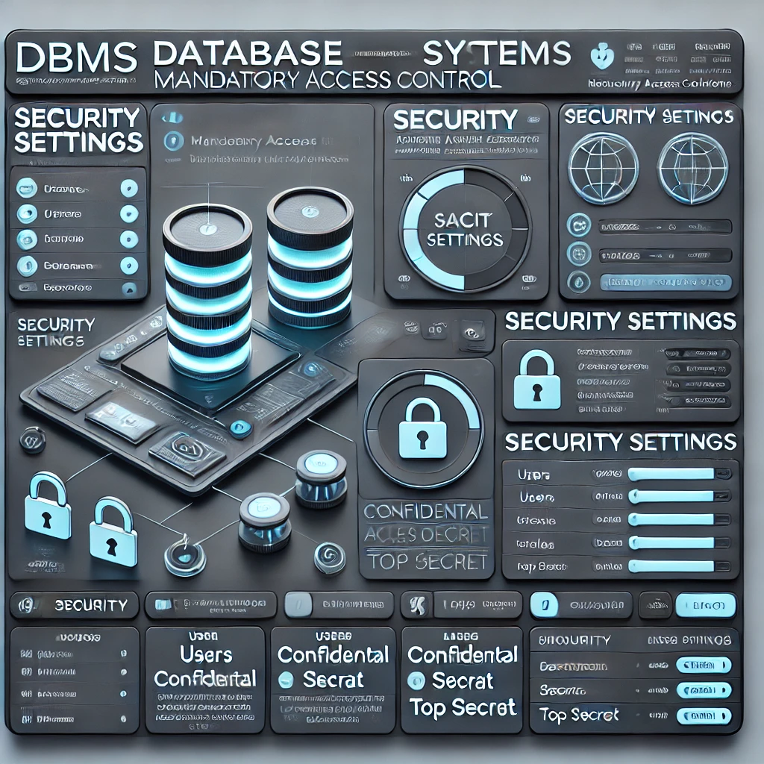
MAC in Database Management Systems (DBMS)
How MAC is Implemented in DBMS:
Security labels are assigned to database objects (tables, rows, columns).
Users are granted access based on their clearance levels.
Example:
A table containing employee salaries is labeled "confidential."
Only users with "confidential" or higher clearance can access it.
Benefits:
Protects sensitive data in multi-user environments.
Ensures data integrity and confidentiality.

Slide 10
Real-World Applications
✅ Government Databases :– Classified information storage and retrieval.
✅ Healthcare Systems :– Protects patient records and medical data.
✅ Financial Institutions :– Secures transactional and customer data.
✅ Defense Systems :– Manages access to mission-critical data.

Slide 11
Conclusion
The Mandatory Access Control (MAC) Model is one of the most secure access control mechanisms used in high-security environments like military, government, and financial systems.
It enforces strict access policies, ensuring confidentiality and integrity by preventing unauthorized access and data leaks.
Though rigid and complex, MAC is essential for protecting classified information and is often used alongside DAC and RBAC for a balanced security approach.
Understanding and implementing MAC enhances database security, making it a crucial model in DBMS security frameworks.
💡 "Security is not a product, but a process." – Bruce Schneier

Slide 12
REFERENCES
📘 "Security Engineering: A Guide to Building Dependable Distributed Systems" – Ross J. Anderson
📗 "Computer Security: Art and Science" – Matt Bishop
📙 "Foundations of Security: What Every Programmer Needs to Know" – Neil Daswani, Christoph Kern, and Anita Kesavan
📕 "Access Control Systems: Security, Identity Management and Trust Models" – Messaoud Benantar
📒 "Introduction to Computer Security" – Michael T. Goodrich and Roberto Tamassia

Slide 13



